Slide 1


The 2024 NJACP STARS! Ad Show

Slide 2



Thank-you to Our Sponsors
Diamond Plus Sponsors:

Slide 3




Thank-you to Our Sponsors
Diamond Sponsor:
Platinum Sponsors:

Slide 4
Special Guest Videos:
A special thank-you to the following persons who took the time to create and send us a video for the STARS! celebration…
● Kaylee McGuire, DHS Deputy Commissioner
● Speaker of the Assembly Craig Coughlin (D-19)
● NJ State Senator Gordon M. Johnson, Assistant Majority Leader (D-37)
● NJ State Senator Patrick Diegnan Jr. (D-18)
● NJ State Senator Vin Gopal (D-11)
● NJ State Senator Latham Tiver (R-8)
● NJ State Senator Andrew Zwicker (D-16)
● NJ Assemblywoman Aura Dunn (R-25), Co-Chair of the Disability Caucus
● NJ Assemblyman John Allen (D-32)
● NJ Assemblywoman Margie Donlon M.D. (D-11)
● NJ Assemblywoman Luanne M. Peterpaul Esq. (D-11)
●NJ Assemblywoman Shama Haider (D-37)

Slide 5
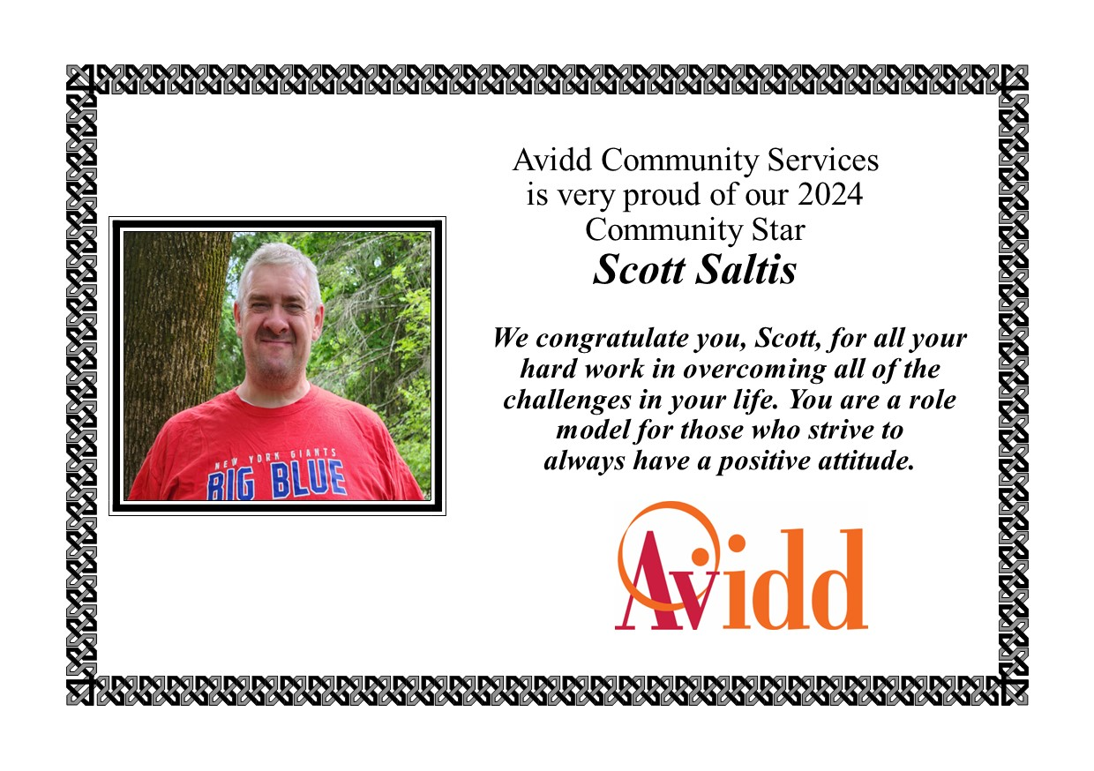

Slide 6
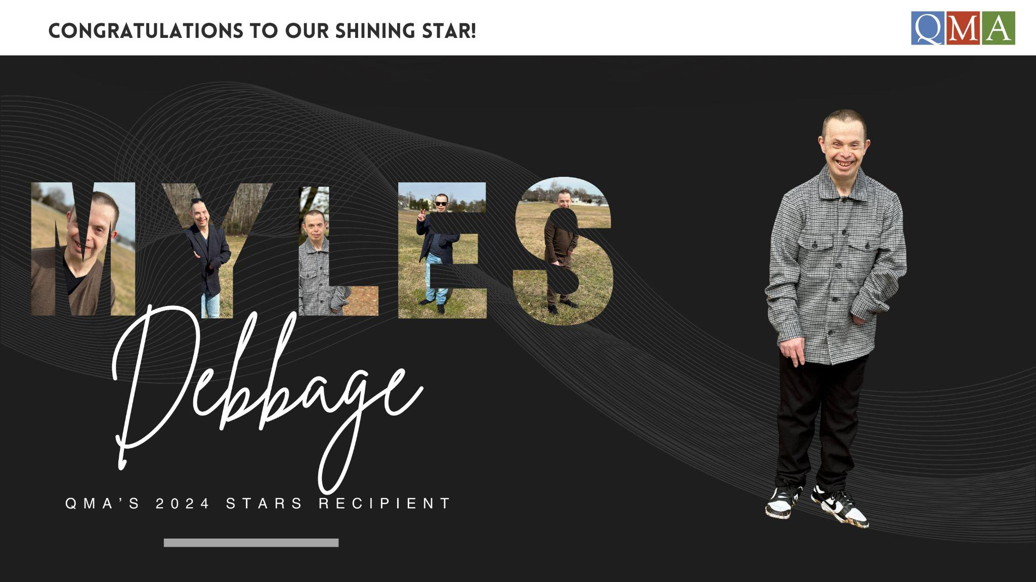

Slide 7


Slide 8


Slide 9
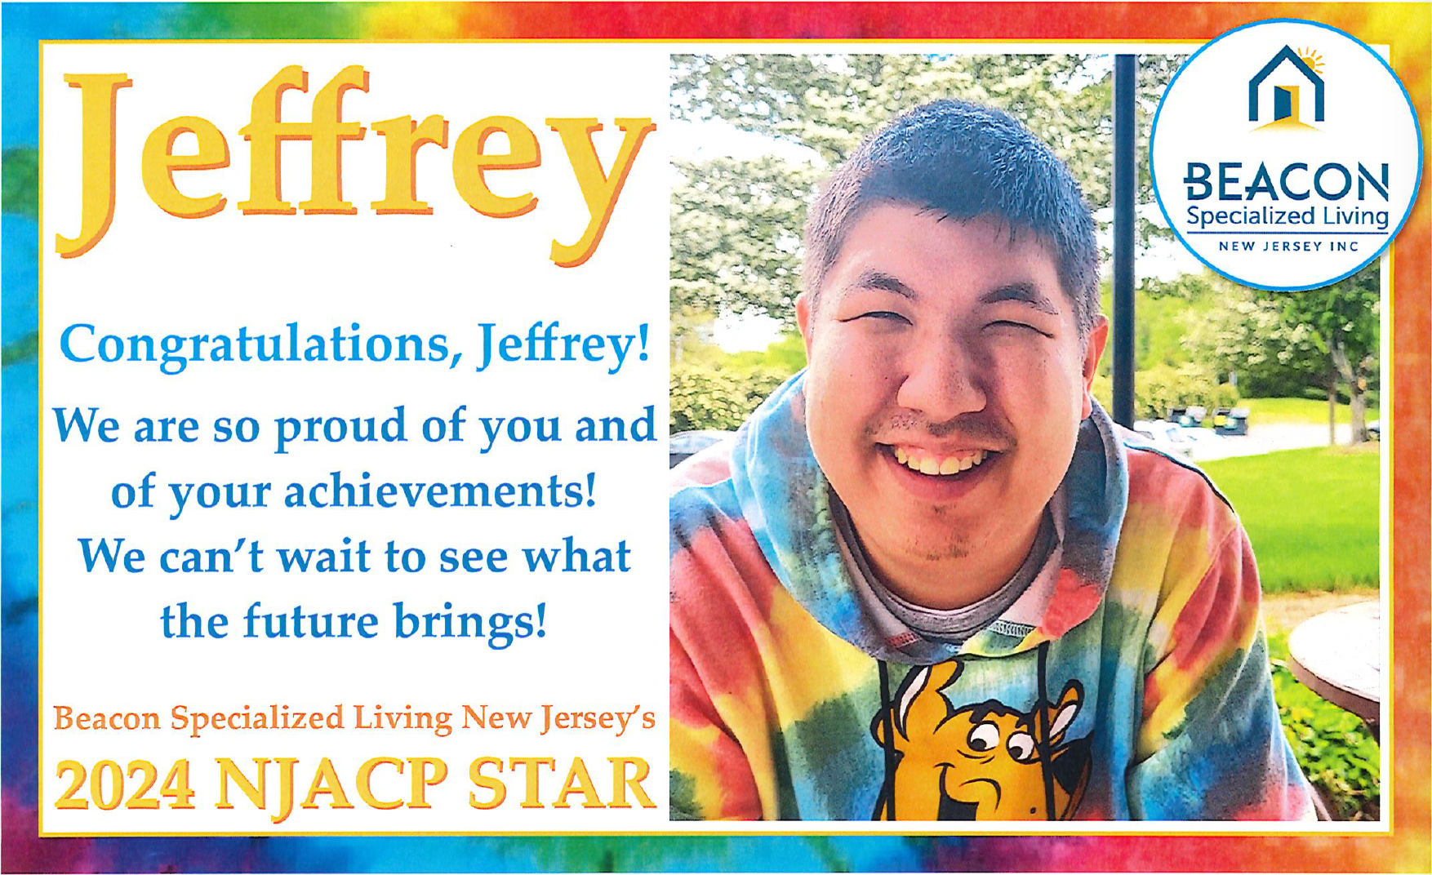

Slide 10


Slide 11
STARS! Captains:
Thank-you to the following captains who helped make this event possible…
Mariah Hall (21 Plus, Inc.) ● Stacey Hawkins (Abilities of Northwest NJ) ● Katherine (Katie) Siwy (Alternatives Inc.)
● Maureen Idleman (Avidd Community Services of NJ) ● Chirylene Mims (Bancroft)
● Robyn Steinman (Beacon Specialized Living NJ) ● Jennifer Manno (Delta Community Supports)
● Fran Szabo (Department for Persons with Disabilities, Diocese of Paterson/DPD)
● Sabrina Houston-Bey (Devereux Advanced Behavioral Health NJ) ● Pedro Vargas (Dungarvin)
● Brooks Sanders (Eden Autism) ● Alyssa Chalow (Elwyn NJ) ● Delicia Hernandez (Everas Community Services)
● Michael Pearson, Jr. (Family Resource Network) ● Shaleice Jenkins (JESPY House)
● Shila Baidoo (Jewish Services for the Developmentally Disabled/JSDD) ● Regina Woods (Kelsch Associates of NJ)
● Malika Smith (Merakey) ● Amanda Jordan (Midland Adult Services)
● Meghan Jacob (National Institute for Persons with Disabilities/NIPD) ● Christopher Morano (NJ Institute for Disabilities/NJID)
● Portia Ogawa (Oaks Integrated Care) ● Robert Missovoulos (Occupational Training Center Services)
● Angela Coyoy-Alvarado (Partnerships for People) ● Shana James (Pennreach)
● Lakia Roberts (Quality Management Associates/QMA) ● Matilda (Maddie) Lobban (ResCare)
● Courtney Clarke (SERV Achievement Centers) ● Maxine Antoine (Their Place)

Slide 12


Slide 13
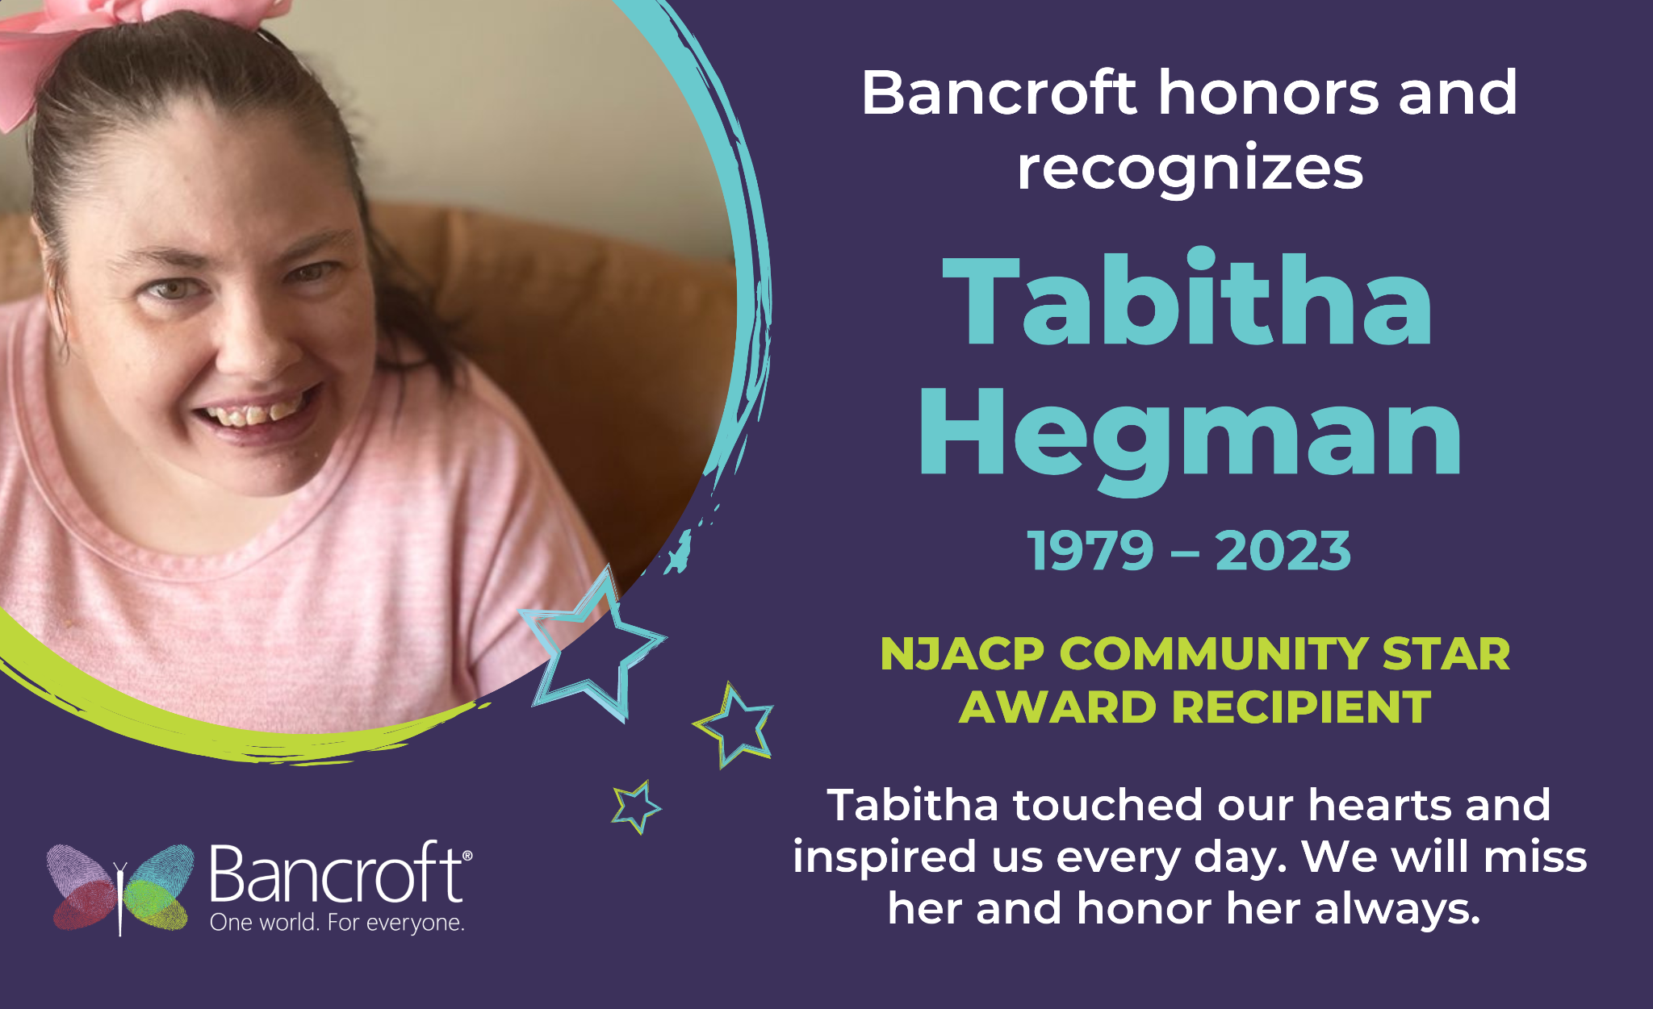

Slide 14
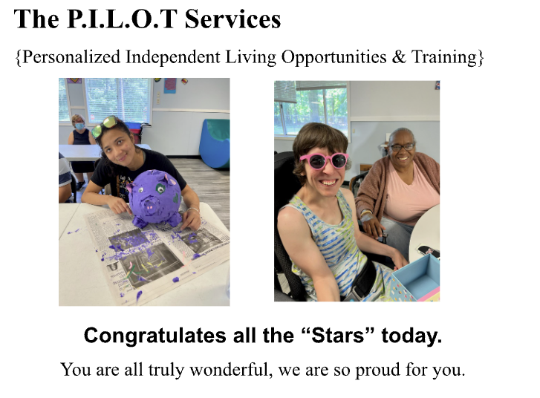

Slide 15


Slide 16
Thank-you to Our Sponsors
Gold Sponsors:
• Department for Persons with Disabilities, Diocese of Paterson (DPD)
• Devereux Advanced Behavioral Health NJ
• NJ Institute for Disabilities (NJID) • Serv Achievement Centers
Silver Sponsor:
Jewish Services for the Developmentally Disabled (JSDD)
Bronze Sponsors:
Eden Autism Services • Everas Community Service, Inc. • Oaks Integrated Care

Slide 17


Slide 18


Slide 19


Slide 20


Slide 21


Slide 22
STARS! Graphic Design Entries
NJACP thanks all of those who submitted entries for the STARS! logo from:
● 21 plus
● Beacon Specialized Living NJ
● Devereux Advanced Behavioral Health
● JESPY House
● Jewish Services for the Developmentally Disabled (JSDD)
● Partnerships for People
All of your submissions were remarkable. Thank-you for sharing them with us.
We hope you will continue to submit entries in the future.

Slide 23


Slide 24


Slide 25


Slide 26


Slide 27


Slide 28


Slide 29


Slide 30
NJACP appreciates the continued support of our Strategic Partners:
● Butler Human Services ● Decades Construction
● Delta T Group ● Emerald Business Supplies
● eVero Corporation ● Interstate Fleet Services
● Matthijssen Business Systems ● Mercadien ● Relias
● Risk Strategies (Meeker Sharkey & Hurley) ● Rue Insurance
● Schenck, Price, Smith & King, LLP
● Tarrytown Expocare Pharmacy

Slide 31


Slide 32


Slide 33


Slide 34


Slide 35
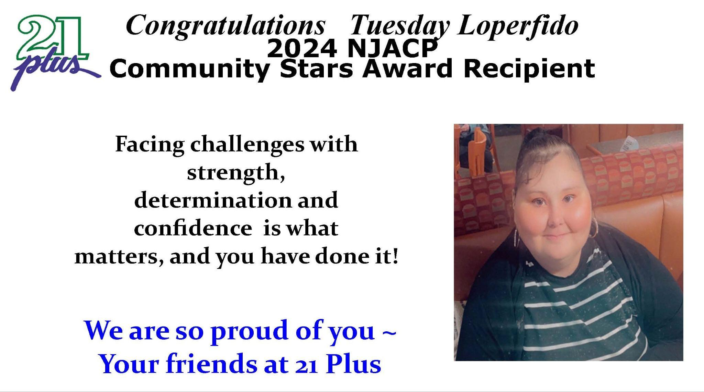

Slide 36
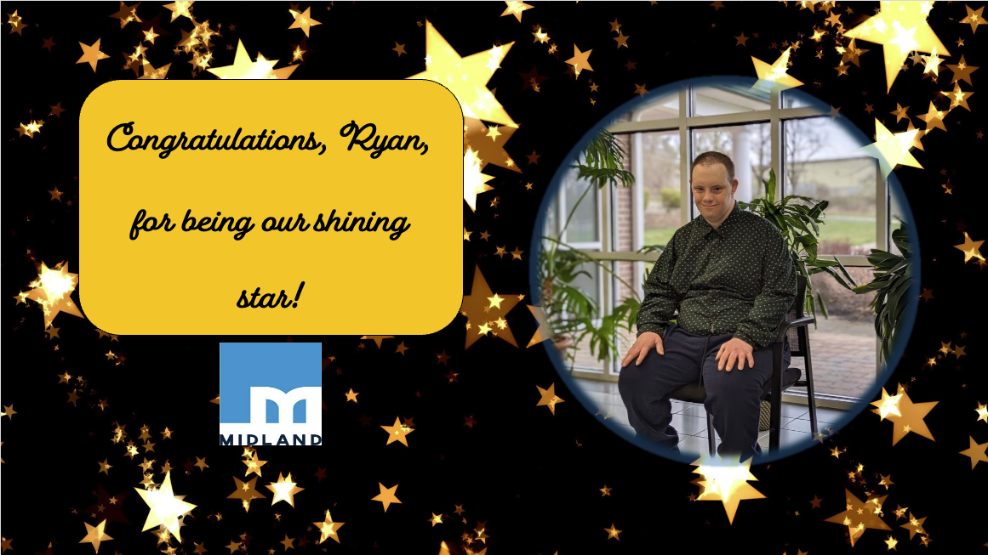

Slide 37


Slide 38
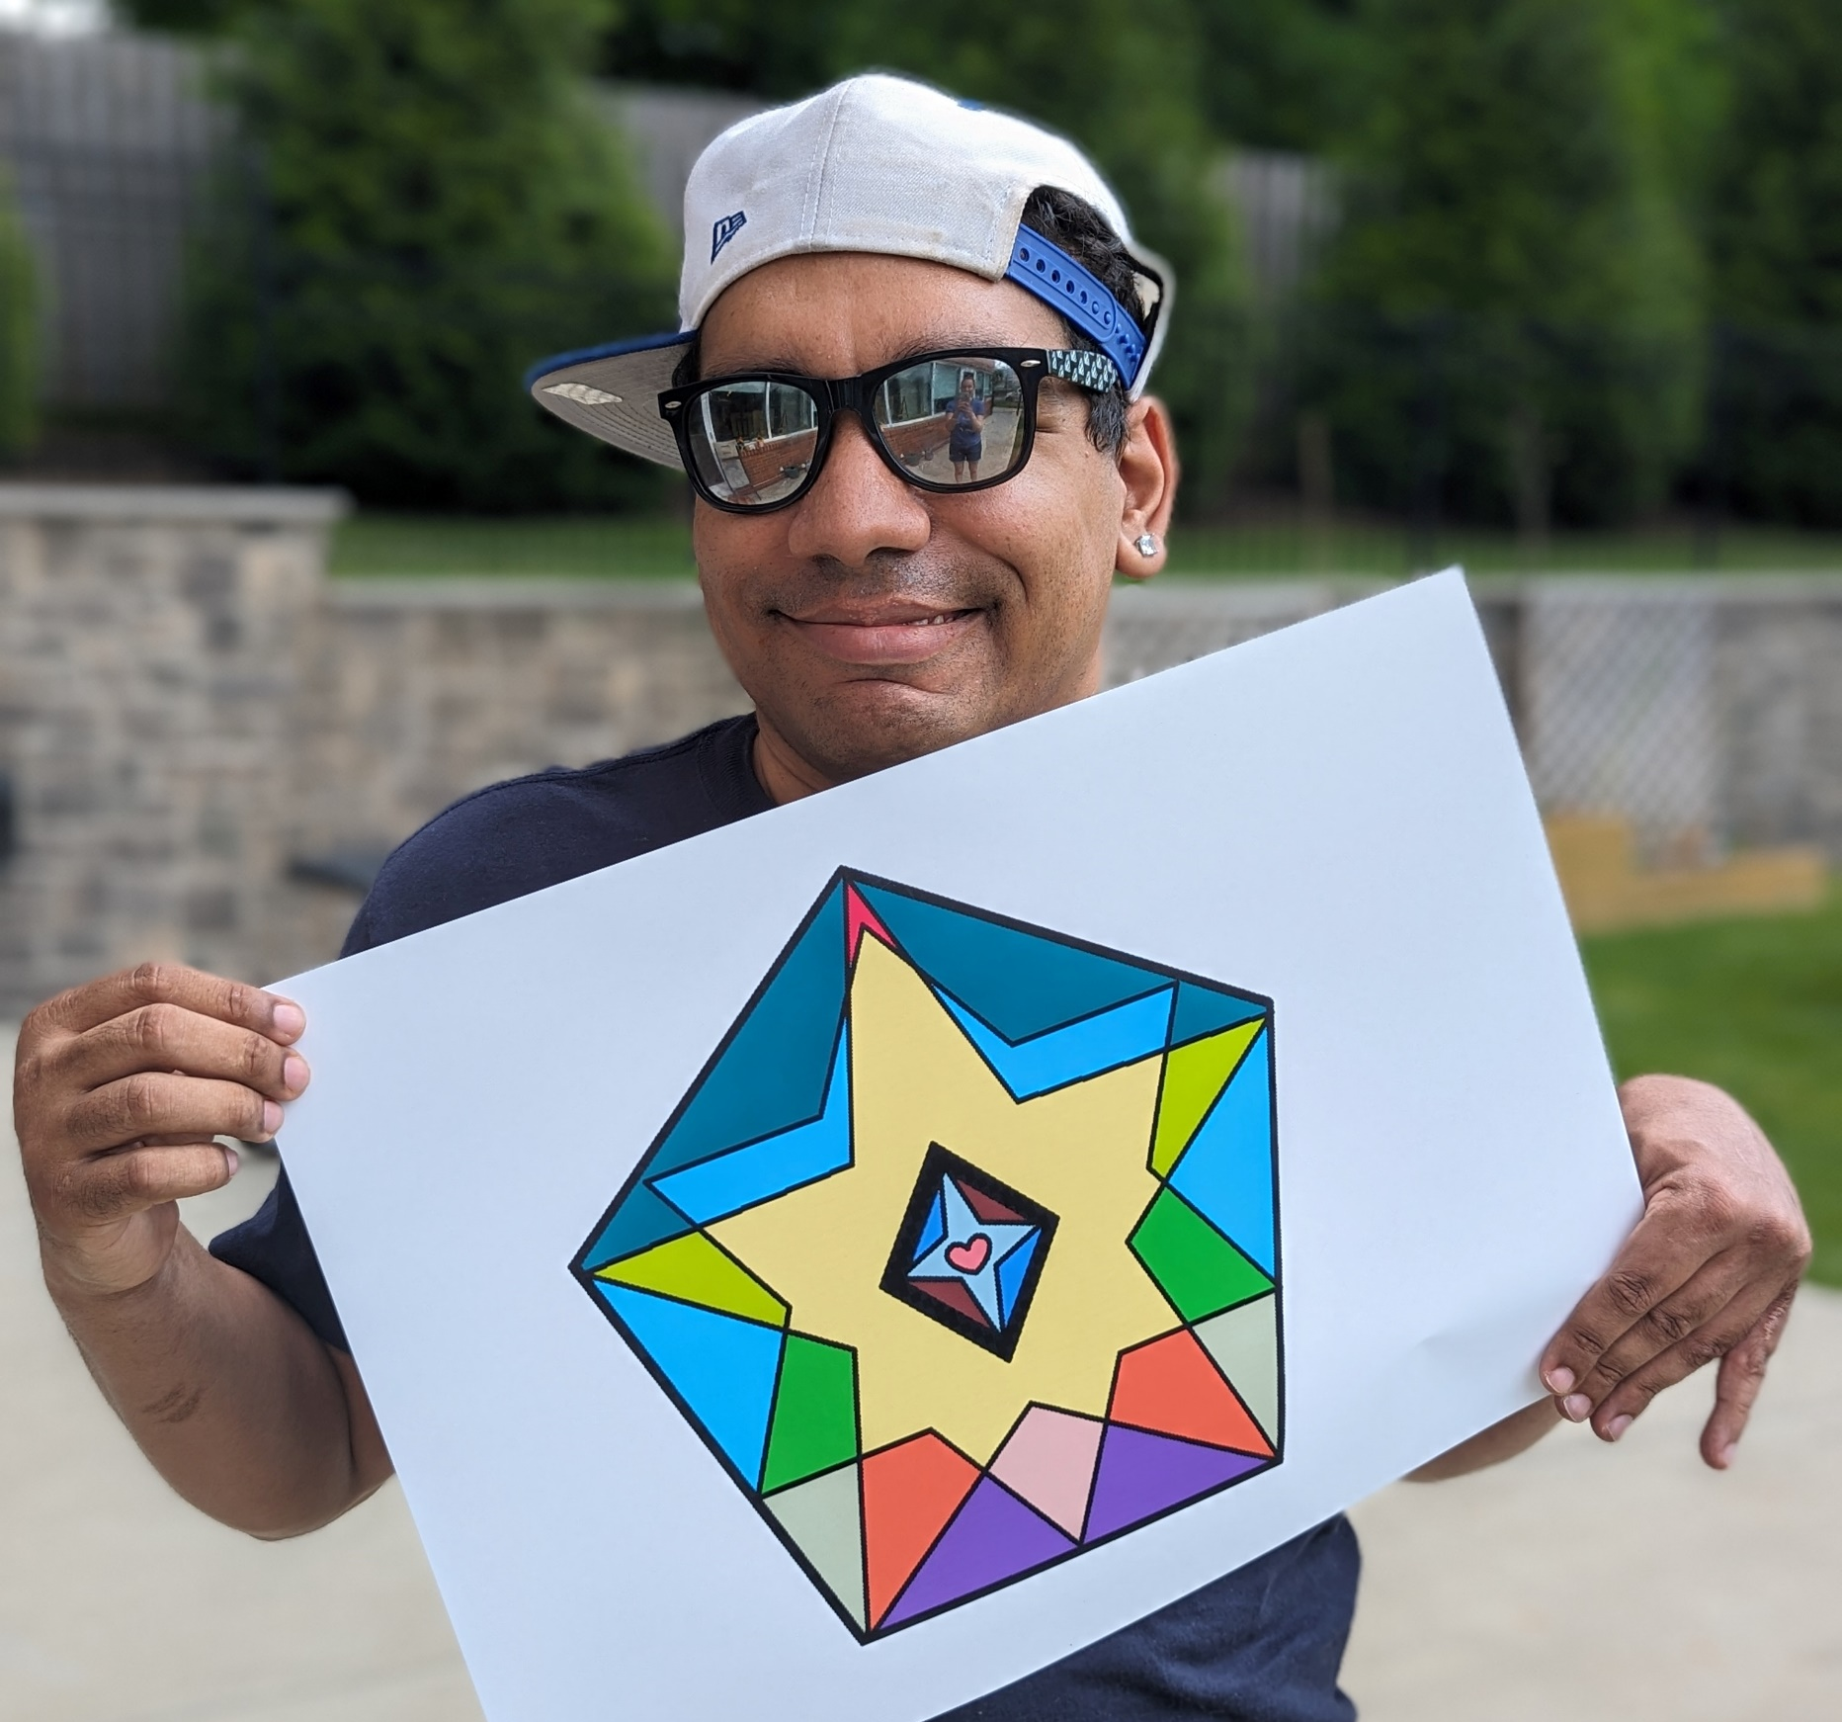

STARS! Logo Design Winner:
Angel
from Jewish Services for the Developmentally Disabled (JSDD)
One of Angel’s favorite things to do is work on the computer. You can often find him there creating digital art by combining shapes, bold colors and strong lines. He also enjoys mixing photography with his digital artwork. Angel wants people to feel happy when they look at his work.

Slide 39


Slide 40


Slide 41


Slide 42


Slide 43
Advertisers:
We appreciate the support of our Advertisers!
21 Plus, Inc. ● Alternatives Inc. ● Avidd Community Services of NJ ● Bancroft
● Beacon Specialized Living NJ ● Butler Human Services ● CIL ● Decades Construction ● Delta T Group
● Department for Persons with Disabilities, Diocese of Paterson (DPD)
● Devereux Advanced Behavioral Health NJ ● Eden Autism ● Elwyn NJ ● Emerald Business Supply
● Everas Community Service, Inc. ● eVero Corporation ● Interstate Fleet Services ● JESPY House
● Jewish Services for the Developmentally Disabled (JSDD) ● Matthijssen Business Systems
● Mercadien ● Midland Adult Services ● NJ Institute for Disabilities ● Oaks Integrated Care
● Occupational Training Center ● Pennreach ● Quality Management Associates (QMA) ● Relias
● Risk Strategies (Meeker Sharkey & Hurley) ● Rue Insurance ● Schenck, Price, Smith & King, LLP
● SERV Achievement Centers ● Tarrytown Expocare Pharmacy ● The P.I.L.O.T. Services
● Primepoint ● Special Considerations ● Therap

Slide 44


Slide 45


Slide 46
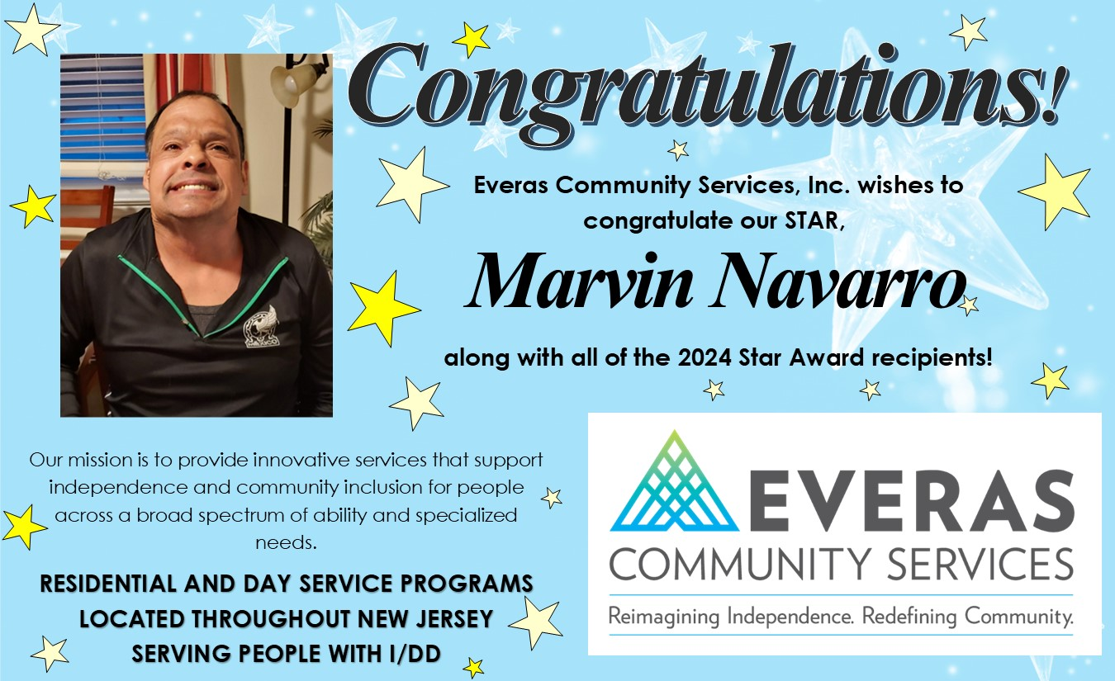

Slide 47
Member Resources Committee:
Co-Chairs: Audrey Winkler, JESPY House, and
Terry McKeon, Avidd Community Services of NJ
● Danielle Casolaro, Northern Region Educational Services Commission
● Dara Reagan, Alternatives Inc.
● Debbie Cmielewski, Schenck, Price, Smith & King, LLP
● Joanna Miller, Department for Persons with Disabilities, Diocese of Paterson (DPD)
● Kimberly Davis, Devereux Advanced Behavioral Health NJ
● Lisa Gugger, NJ Institute for Disabilities
● Mary Nardone, Bancroft
● Maureen Idleman, Avidd Community Services of NJ
● Michelle Habingreither, Bancroft
● William Placek, NJ Institute for Disabilities
● NJACP Staff: Valerie Sellers-CEO, Colleen Klepser, and Torilyn Villafana

